Slide 1
E-Commerce Sales Analysis Driving Revenue Growth Through Data
Suzain Khan Internship Final Presentation March 2026

Slide 2
Business Objective & Scope
Objective
Analyze historical sales performance
Identify key revenue drivers
Understand customer value segmentation
Forecast future sales trends
Provide strategic recommendations

Slide 3
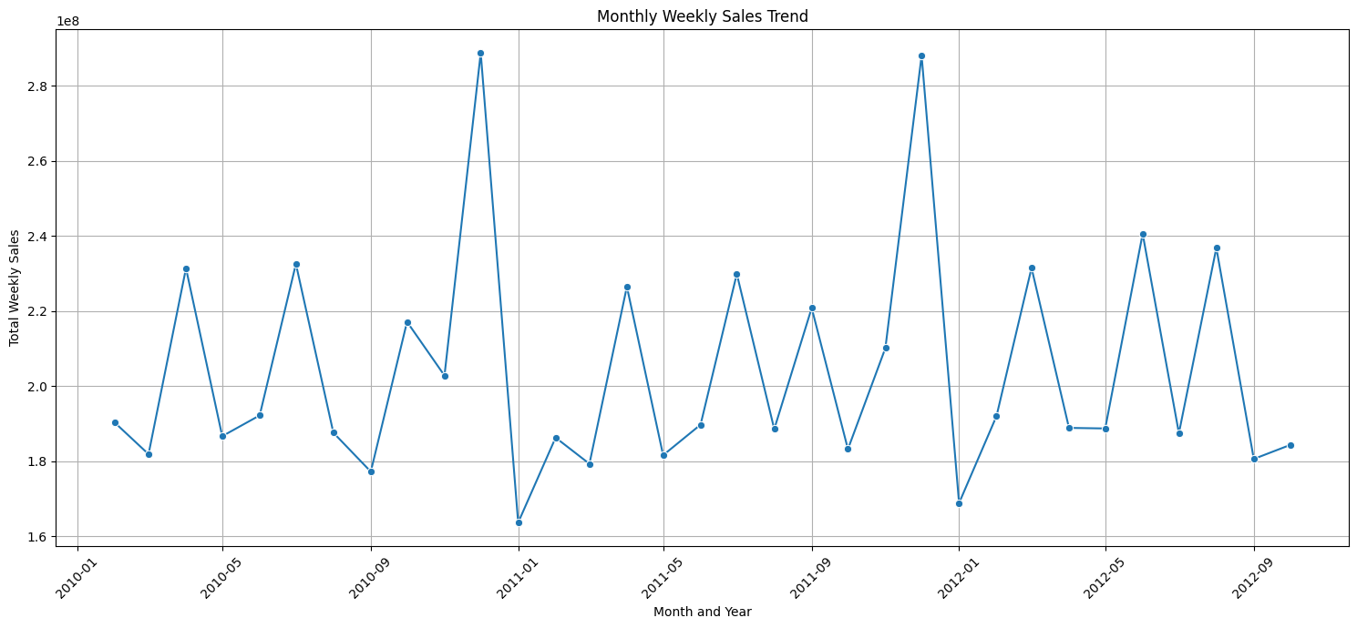
Overall Sales Performance
Key Insights
Strong year-end peaks
Early-year dip
Mid-year spike (July)
Sales show seasonal dependency
Main Message: Sales are highly seasonal and sensitive to market conditions.
Sales are highly seasonal and sensitive to external market conditions

Slide 4
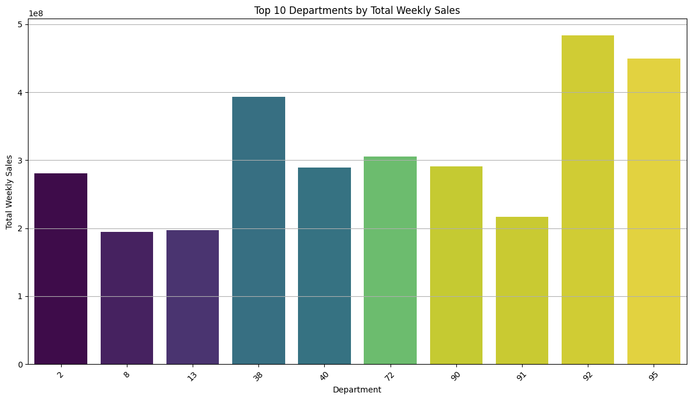
Product Performance Analysis
Key Insights
Departments 92, 95, 38, 72, 90 dominate revenue
Department 48 shows consistent growth
Revenue concentrated in few categories
Main Message: Invest in resilient and high-performing categories.
Revenue growth depends on strengthening high-performing and resilient categories.

Slide 5
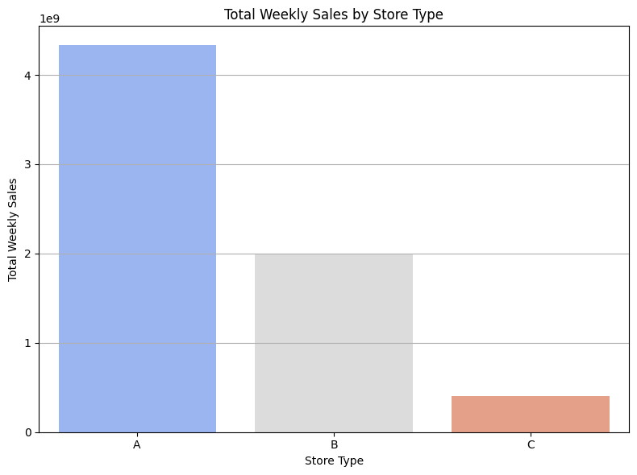
Geographic & Store Performance
Key Insights
Type A stores generate majority of revenue
Type C stores significantly underperform
Store format strongly impacts profitability
Main Message: Revenue performance is highly dependent on store format, with Type A stores significantly outperforming other formats
Store format is a critical driver of overall revenue performance.

Slide 6
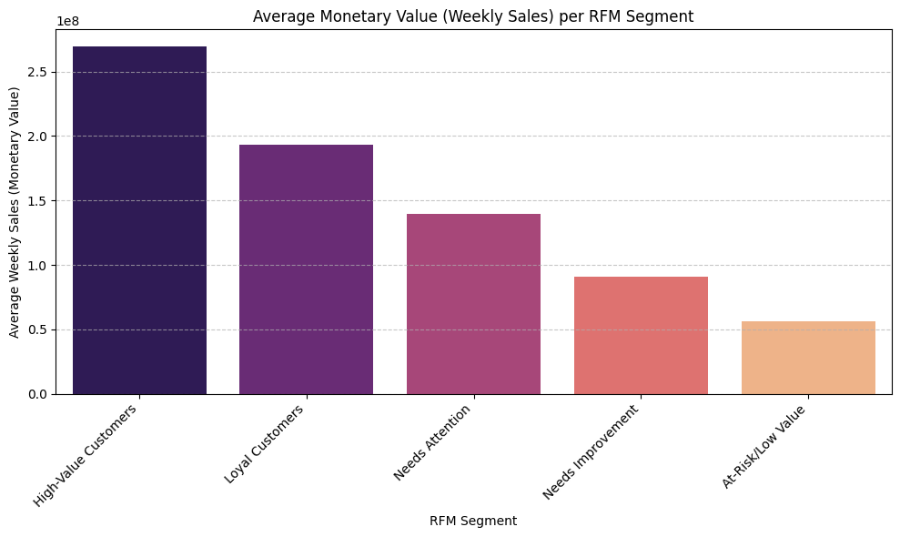
Customer Segmentation (RFM)
Key Insights
High-Value Customers generate highest revenue
Monetary value is primary differentiator
Significant gap between top and bottom segments
Upsell opportunity in mid-tier segments
Main Message:
Customer value is strongly differentiated by monetary contribution, with high-value segments generating disproportionate revenue
Monetary contribution is the primary differentiator of customer value.

Slide 7
Cross-Selling & Customer Behaviour
Key Findings
Strong correlation between Dept 24 & 33 (0.97)
Strong correlation between Dept 90 & 92 (0.97)
Certain departments consistently purchased together
Main Message:
Customer purchasing patterns reveal strong bundling opportunities that can increase average transaction value
Strategic Implication: Introduce targeted bundling and cross-promotions to increase basket size.

Slide 8
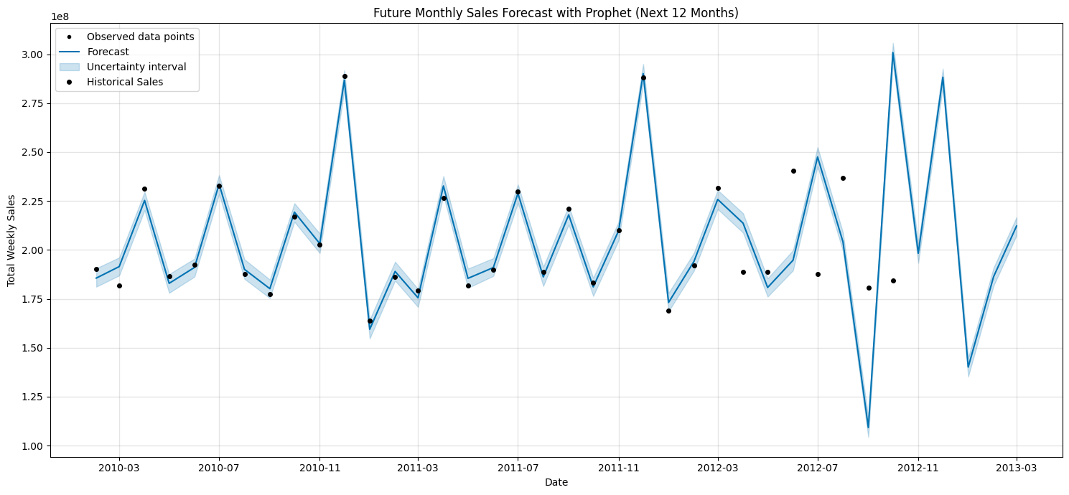
Forecasting Insights
Key Insights
Strong seasonal peaks expected in Nov–Dec
Consistent dips projected in Jan–Feb
Overall trend shows stable to slightly declining growth
Forecast accuracy (MAPE): 26.42%
Main Message:
Future growth will not accelerate naturally — strategic intervention is required.
Strategic Implication: Revenue growth must be driven by proactive business strategies, not natural market expansion.

Slide 9
Strategic Recommendations & Expected Impact
Strategic Priorities
Key Actions
Launch a Tiered Loyalty Program for high-value customers
Increase investment in top-performing departments
Implement seasonal pricing optimization
Introduce bundling & cross-selling strategies
Prioritize expansion of high-performing store formats
Expected Business Impact
Higher Customer Lifetime Value
Improved Profit Margins
Reduced Seasonal Revenue Gaps
Better Inventory & Demand Planning
Stronger Data-Driven Decision Culture
Sustainable revenue growth will come from strategic optimization, not organic market expansion.

